Slide 1
Project 3 Pre Model Data Review in Tableau

Slide 2
Pre Machine Learning Model Tableau Data Review
Original data set has over 1,800 columns of national housing data
Scoped the data to around 20 housing + neighborhood features along with market value records
Used Tableau to review different data points correlation to Market Value – to hone in on which values to focus on in building the ML model

Slide 3
Initial Data Review – Market Value as a Dimension is Noisy

Slide 4
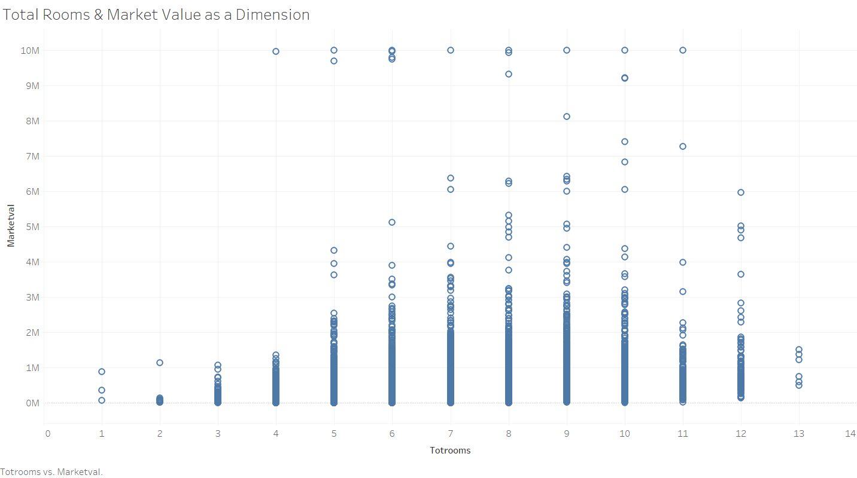

Slide 5
Used Average Market Value to Find Strong Correlation to Features That Drive Value

Slide 6
Housing Features w/Weak Correlation to Average Market Value

Slide 7
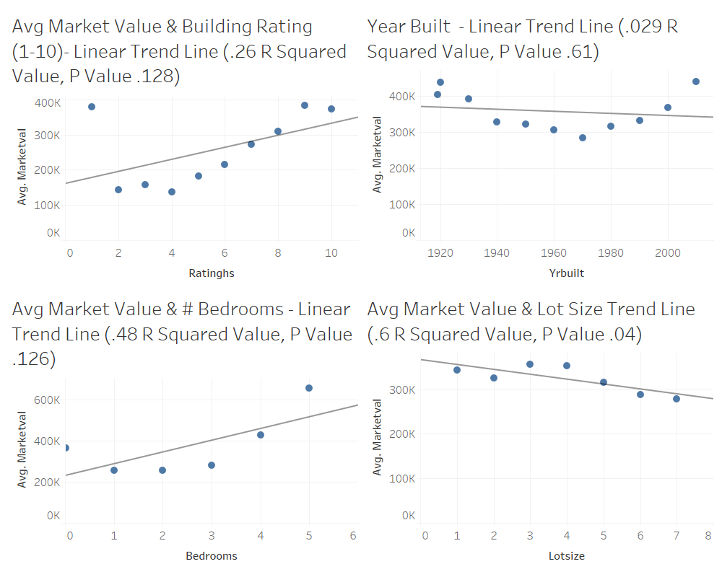

Slide 8
Housing Features w/Strong Correlation to Average Market Value

Slide 9
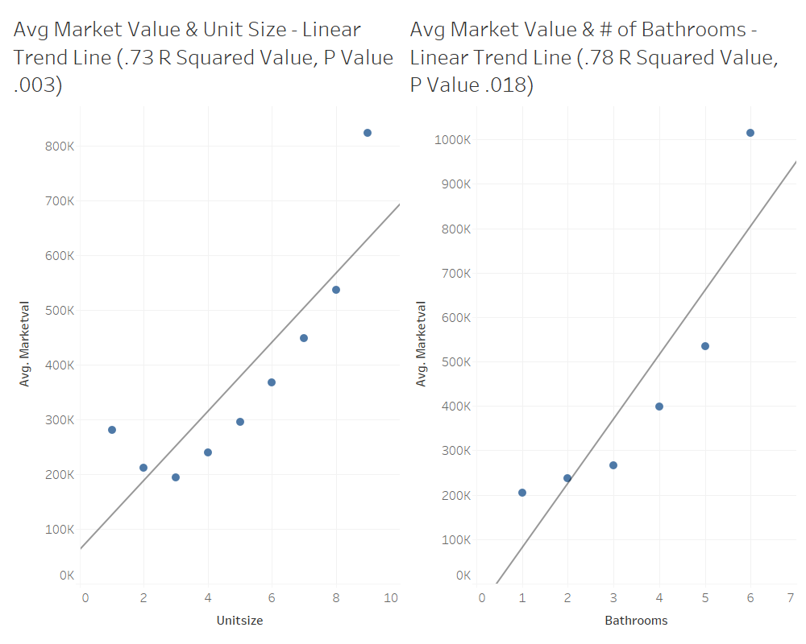

Slide 10
Interesting Trend Data We Found

Slide 11
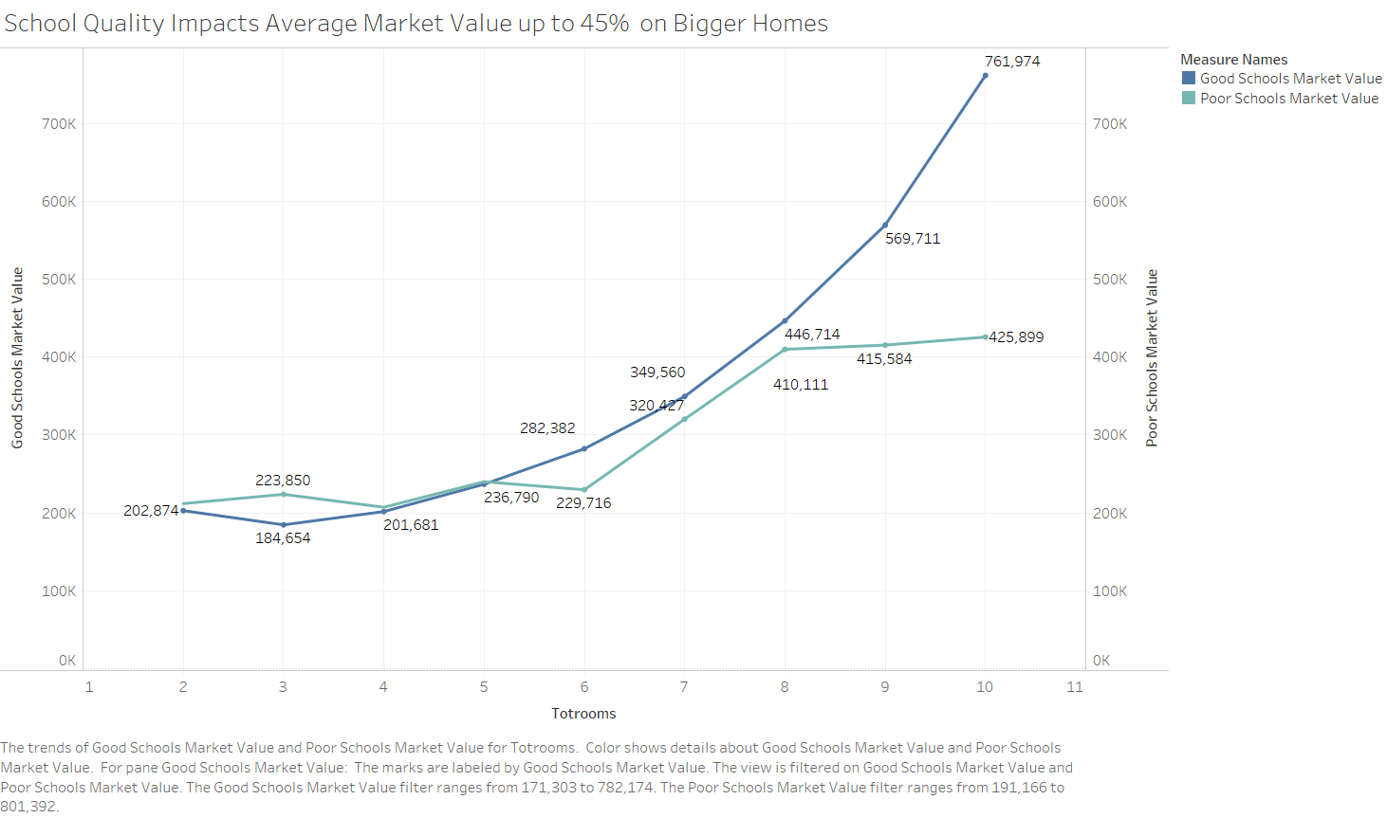

Slide 12
